Slide 1


Lecture 2
DLI
Axioms of Probability
概率论公理

Slide 2
DLI
Outline
Sample Space and Events 样本空间和事件
Axioms of Probability 概率公理化
Some Simple Propositions 一些简单命题
Sample Spaces Having Equally Likely Outcomes 等可能结果的样本空间
Probability as a Measure of Belief 概率作为信任度的测量

Slide 3
DLI
Introduction
In this chapter, we introduce the concept of the probability of an event and then show how probabilities can be computed in certain situations. As a preliminary, however, we need to discuss the concept of the sample space and the events of an experiment.

Slide 4
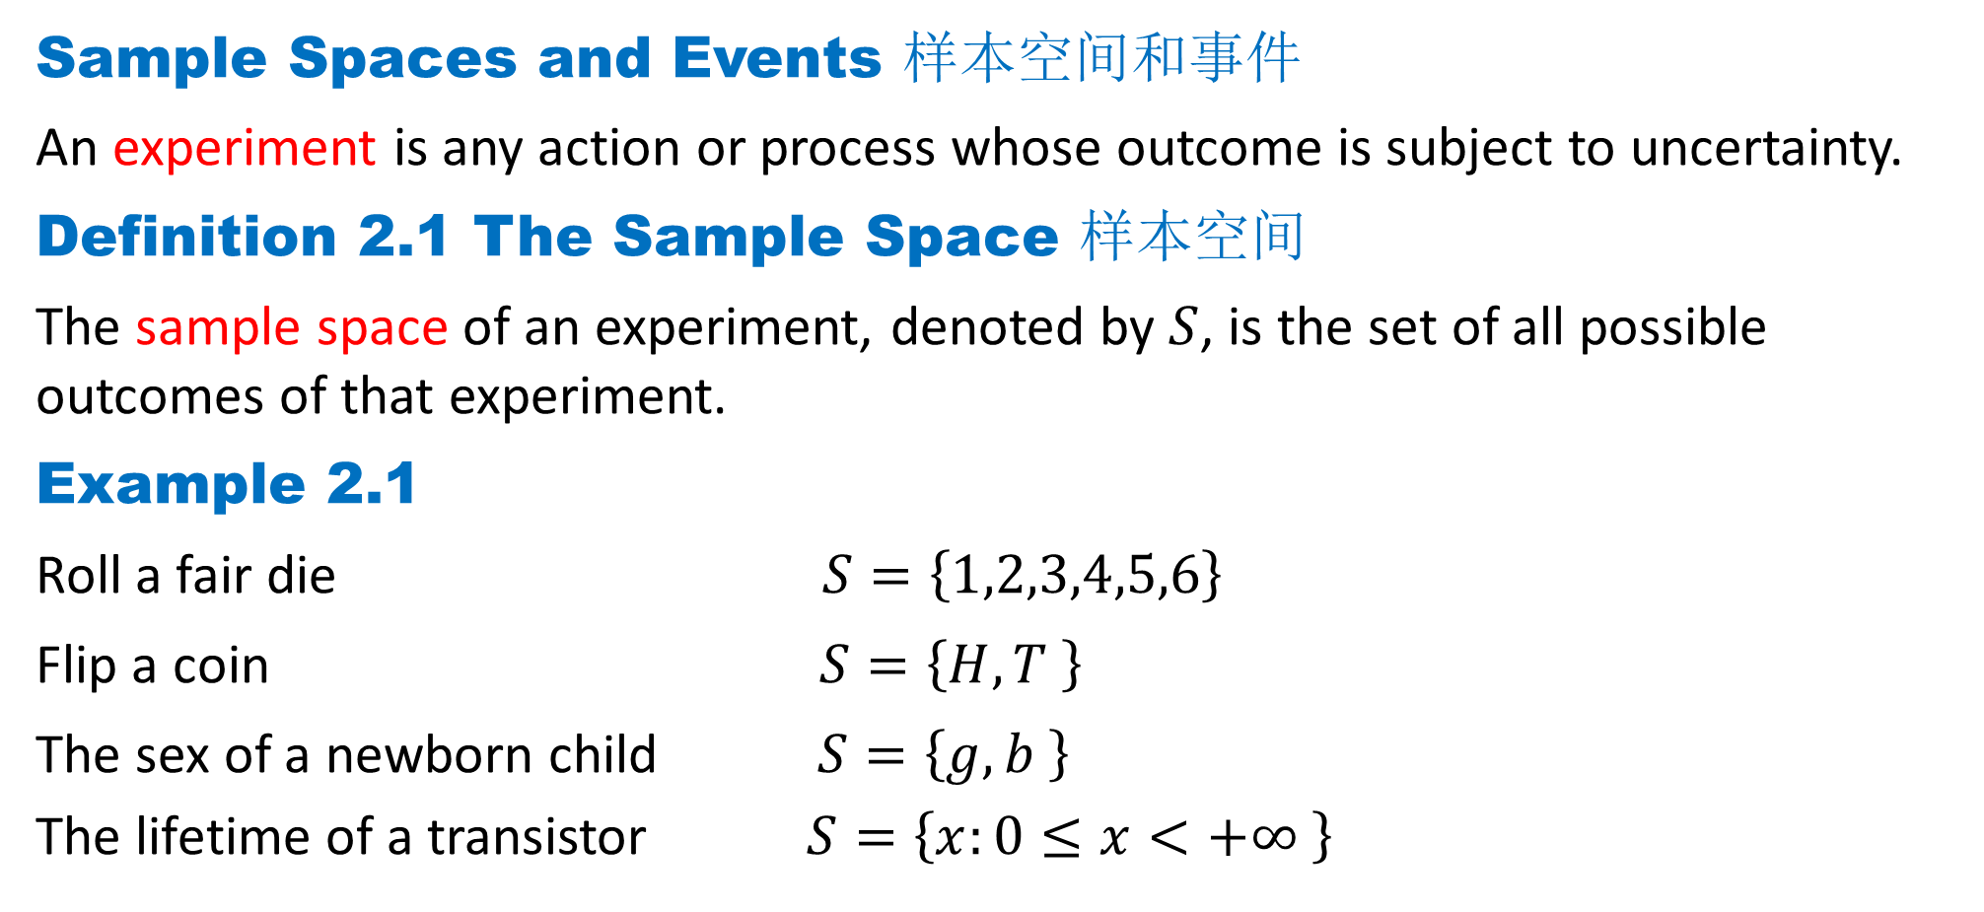
DLI
Sample Spaces and Events 样本空间和事件
An experiment is any action or process whose outcome is subject to uncertainty.
Definition 2.1 The Sample Space 样本空间
The sample space of an experiment, denoted by $S$, is the set of all possible outcomes of that experiment.
Example 2.1
Roll a fair die $S=\left\{1,2,3,4,5,6\right\}$
Flip a coin $S=\left\{H,T \right\}$
The sex of a newborn child $S=\left\{g,b \right\}$
The lifetime of a transistor $S=\left\{x:0≤x<+∞ \right\}$

Slide 5
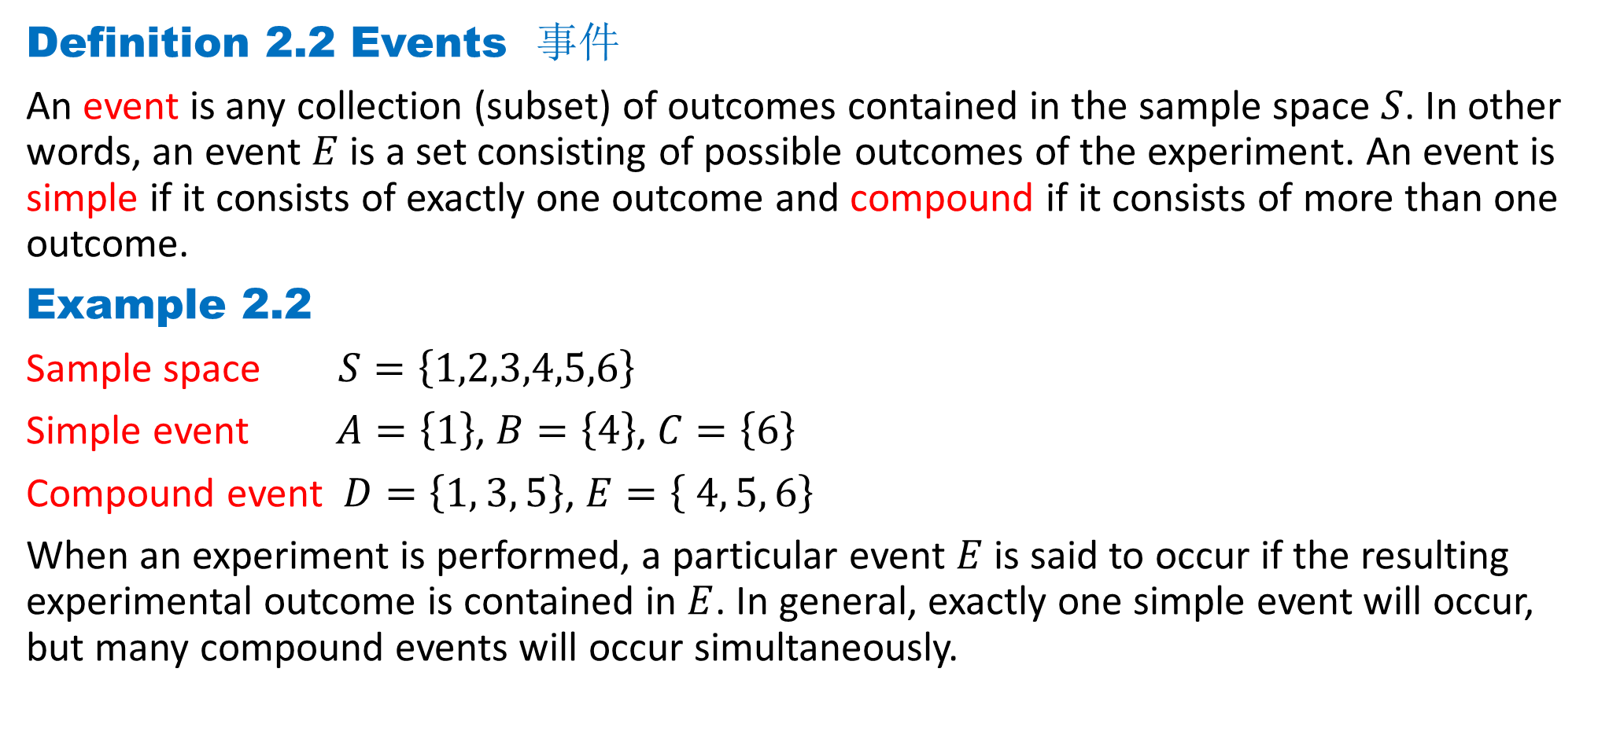
DLI
Definition 2.2 Events 事件
An event is any collection (subset) of outcomes contained in the sample space $S$. In other words, an event $E$ is a set consisting of possible outcomes of the experiment. An event is simple if it consists of exactly one outcome and compound if it consists of more than one outcome.
Example 2.2
Sample space $S=\left\{1,2,3,4,5,6\right\}$
Simple event $A=\left\{1\right\}$, $B=\left\{4\right\}$, $C=\left\{6\right\}$
Compound event $D=\left\{1, 3, 5\right\}$, $E=\left\{ 4, 5, 6\right\}$
When an experiment is performed, a particular event $E$ is said to occur if the resulting experimental outcome is contained in $E$. In general, exactly one simple event will occur, but many compound events will occur simultaneously.

Slide 6
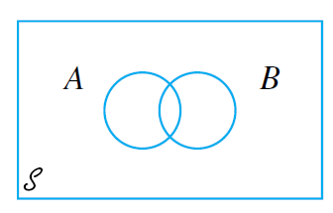
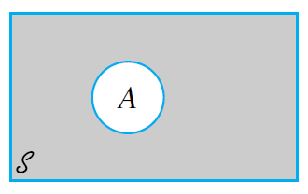
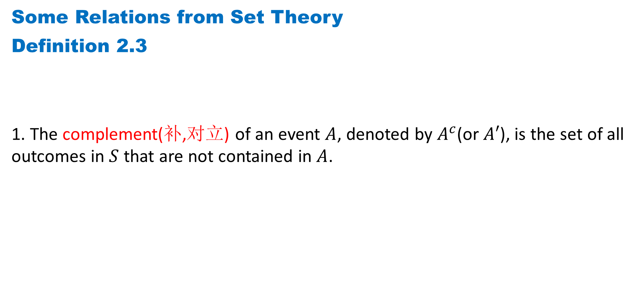
DLI
Some Relations from Set Theory
Definition 2.3
1. The complement(补,对立) of an event $A$, denoted by $A^{c}$(or $A′$), is the set of all outcomes in $S$ that are not contained in $A$.

Slide 7
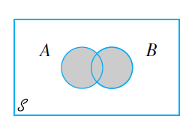
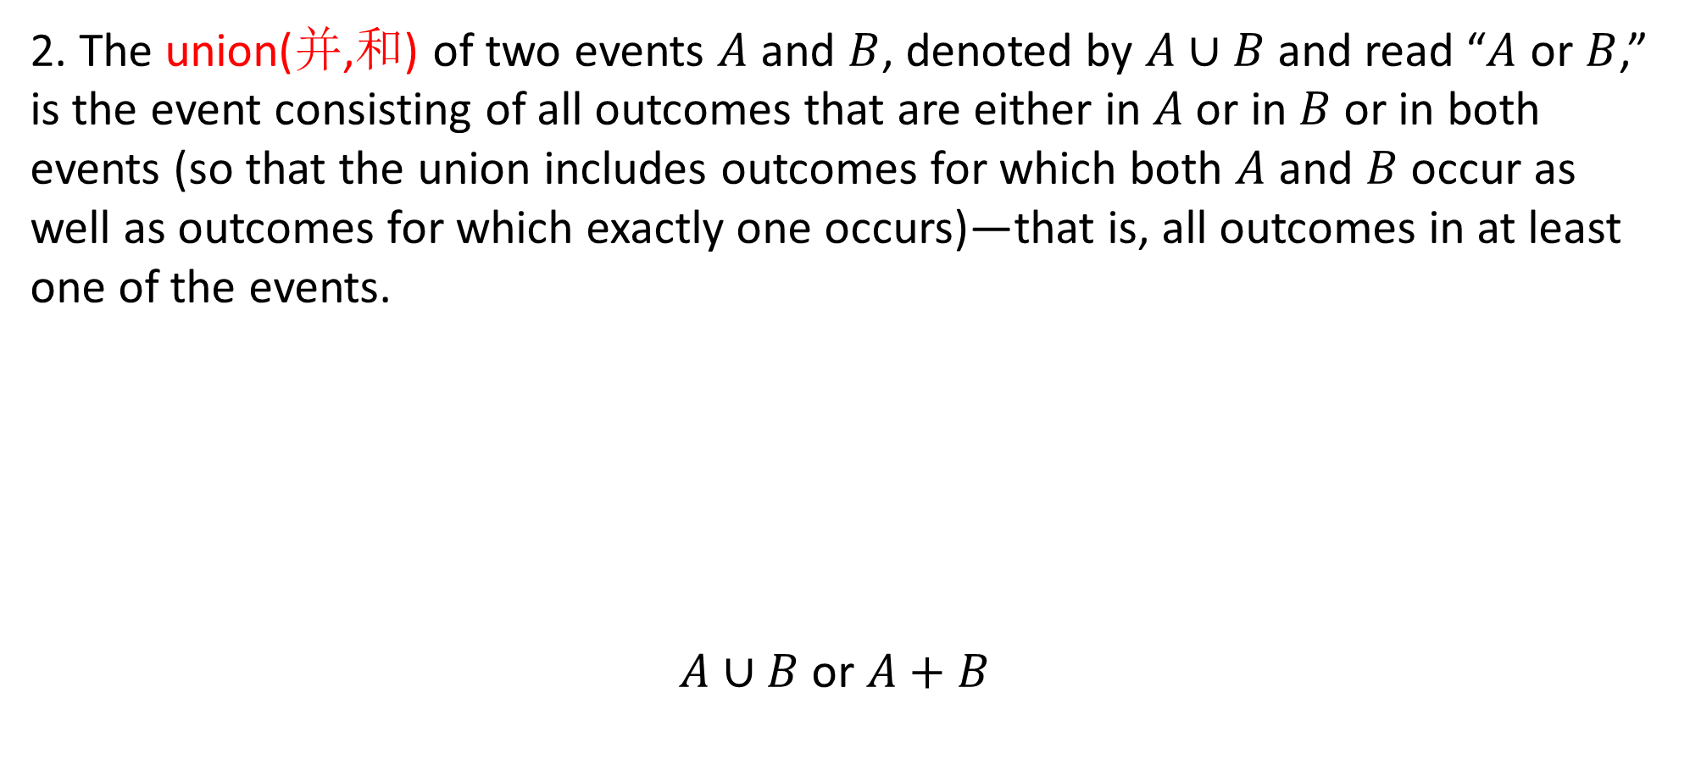
DLI
2. The union(并,和) of two events $A$ and $B$, denoted by $A∪B$and read “$A$ or $B$,” is the event consisting of all outcomes that are either in $A$or in $B$ or in both events (so that the union includes outcomes for which both $A$ and $B$ occur as well as outcomes for which exactly one occurs)—that is, all outcomes in at least one of the events.
$A∪B$ or $A+B$

Slide 8
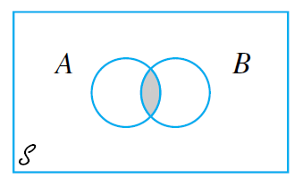

DLI
3. The intersection(交,乘积) of two events $A$ and $B$, denoted by $AB$ (sometimes written $A∩B$) and read “$A$ and $B$,” is the event consisting of all outcomes that are in both $A$ and $B$.
$A∩B$ or $AB$

Slide 9
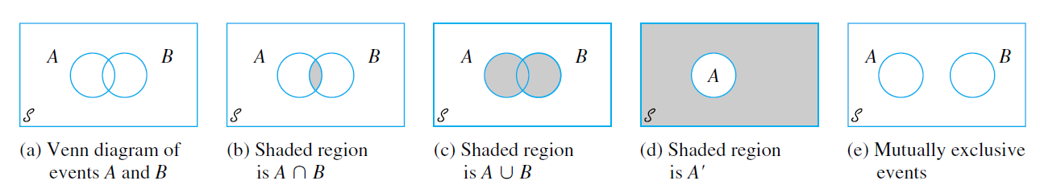

DLI
Sometimes $A$ and $B$ have no outcomes in common, so that the intersection of $A$and $B$ contains no outcomes.
Definition 2.4
Let $∅$ denote the null event(空事件) (the event consisting of no outcomes whatsoever).
When $A∩B=∅$, $A$ and $B$ are said to be mutually exclusive(互斥) or disjoint(不相交) events.
Venn diagrams（维恩图）

Slide 10
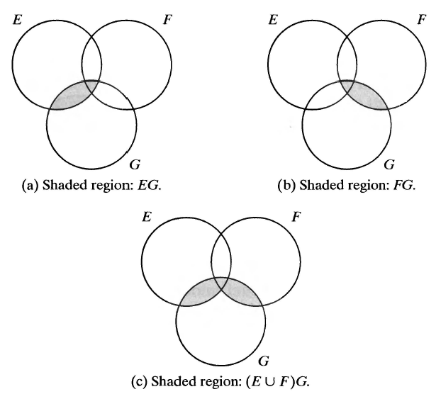
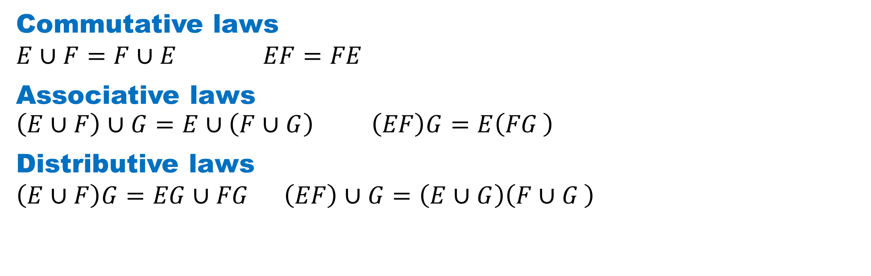

DLI
Commutative laws
$$E∪F=F∪E EF=FE$$
Associative laws
$$\left(E∪F\right)∪G=E∪\left(F∪G\right) \left(EF\right)G=E\left(FG \right)$$
Distributive laws
$$\left(E∪F\right)G=EG∪FG \left(EF\right)∪G=\left(E∪G\right)\left(F∪G \right)$$
$$\left(E∪F\right)G=EG∪FG$$

Slide 11

DLI
De Morgan's laws
$${\left(\bigcup_{i=1}^{n}{A_{i}}\right)}^{′}=\bigcap_{i=1}^{n}{A_{i}^{′}}$$
$${\left(\bigcap_{i=1}^{n}{A_{i}}\right)}^{′}=\bigcup_{i=1}^{n}{A_{i}^{′}}$$

Slide 12
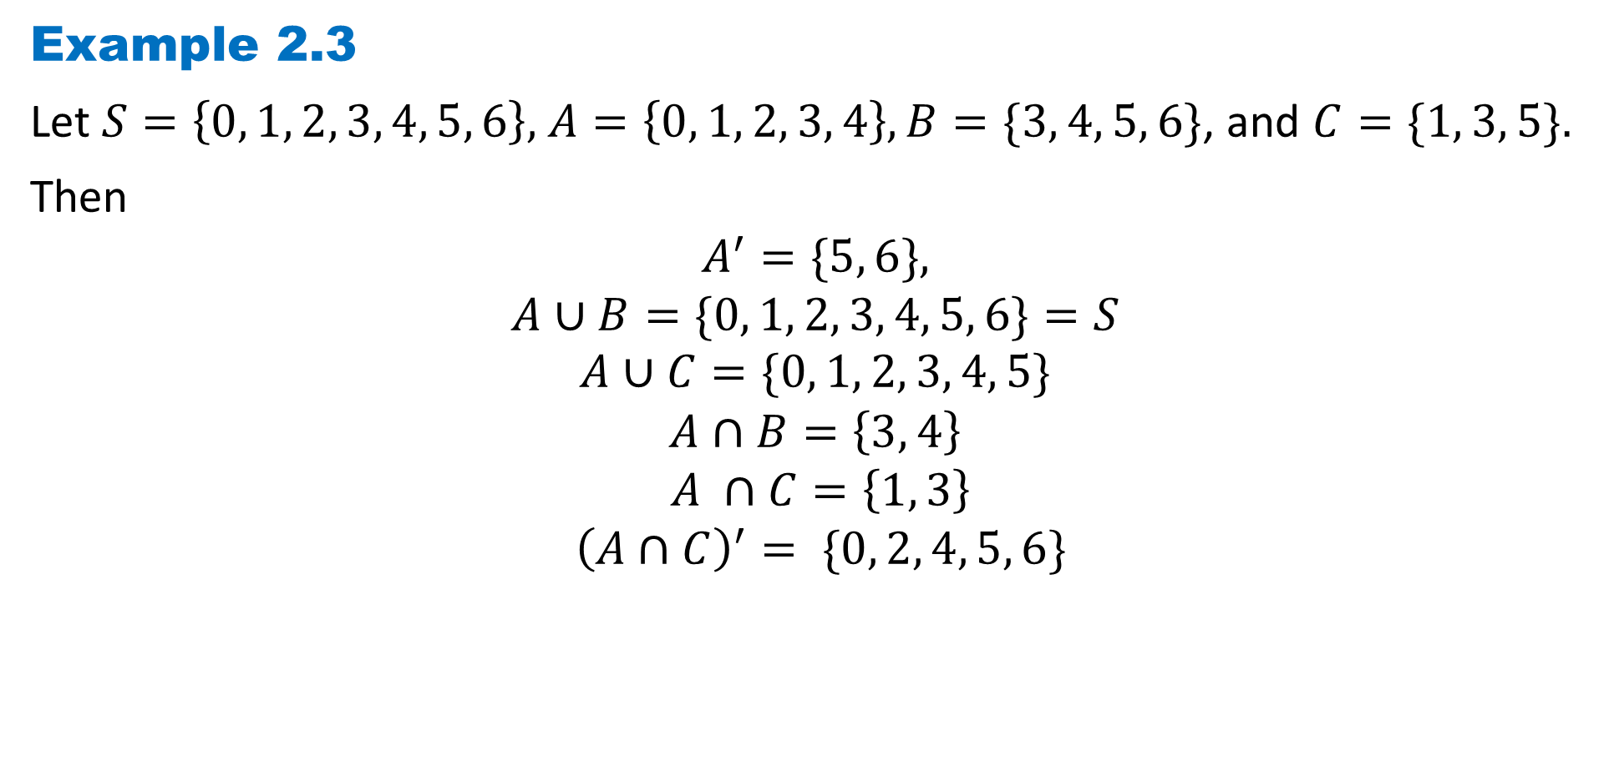
DLI
Example 2.3
Let $S=\left\{0, 1, 2, 3, 4, 5, 6\right\},$ $A=\left\{0, 1, 2, 3, 4\right\}, B=\{3, 4, 5, 6\}$, and $C=\{1, 3, 5\}.$
Then
$$A^{′}=\{5, 6\},$$
$$A∪B=\{0, 1, 2, 3, 4, 5, 6\}=S$$
$$A∪C=\{0, 1, 2, 3, 4, 5\}$$
$$A∩B=\left\{3, 4\right\}$$
$$A ∩C=\left\{1, 3\right\}$$
$${\left(A∩C\right)}^{′}= \{0, 2, 4, 5, 6\}$$

Slide 13
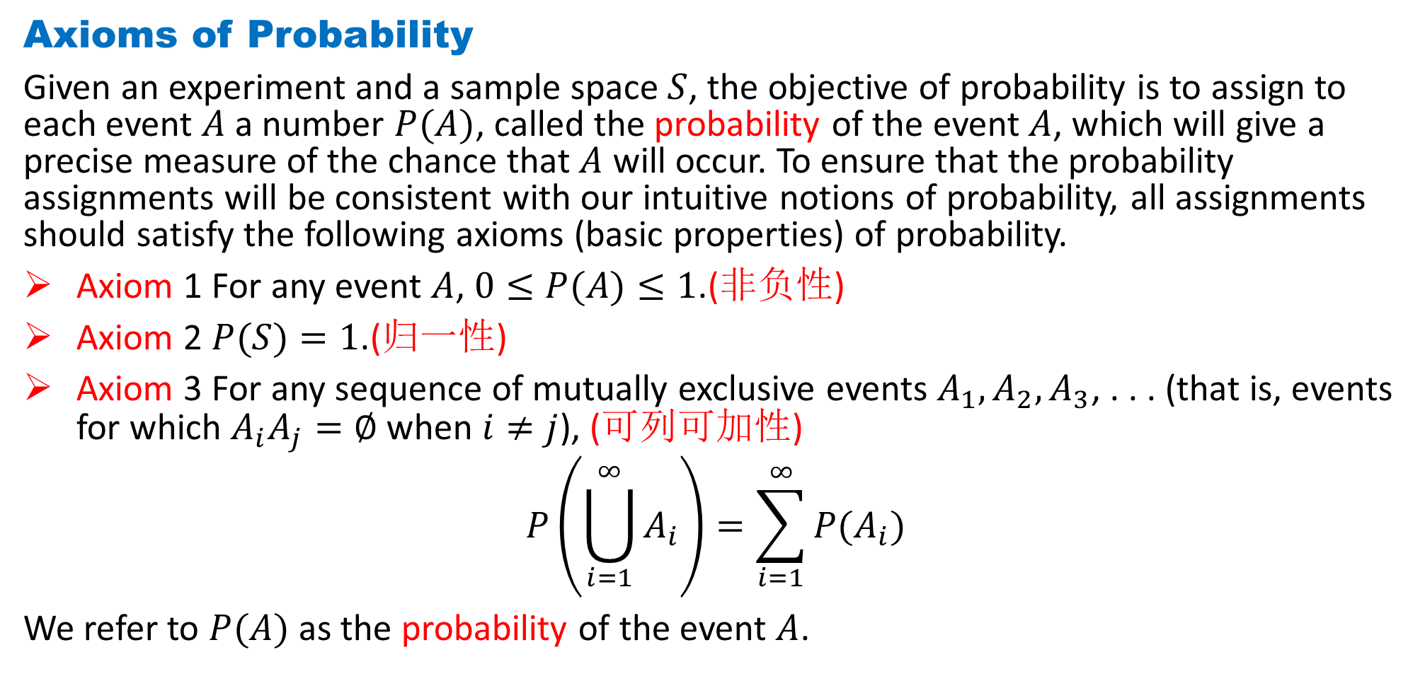
DLI
Axioms of Probability
Given an experiment and a sample space $S$, the objective of probability is to assign to each event $A$a number $P(A)$, called the probability of the event $A$, which will give a precise measure of the chance that $A$ will occur. To ensure that the probability assignments will be consistent with our intuitive notions of probability, all assignments should satisfy the following axioms (basic properties) of probability.
Axiom 1 For any event $A$, $0≤P(A)≤1$.(非负性)
Axiom 2 $P(S)=1$.(归一性)
Axiom 3 For any sequence of mutually exclusive events $A_{1}, A_{2}, A_{3}$, . . . (that is, events for which $A_{i}A_{j}=∅$when $i≠j$), (可列可加性)
$$P\left(\bigcup_{i=1}^{∞}{A_{i}}\right)=\sum_{i=1}^{∞}{P(A_{i})}$$
We refer to $P(A)$ as the probability of the event $A$.

Slide 14
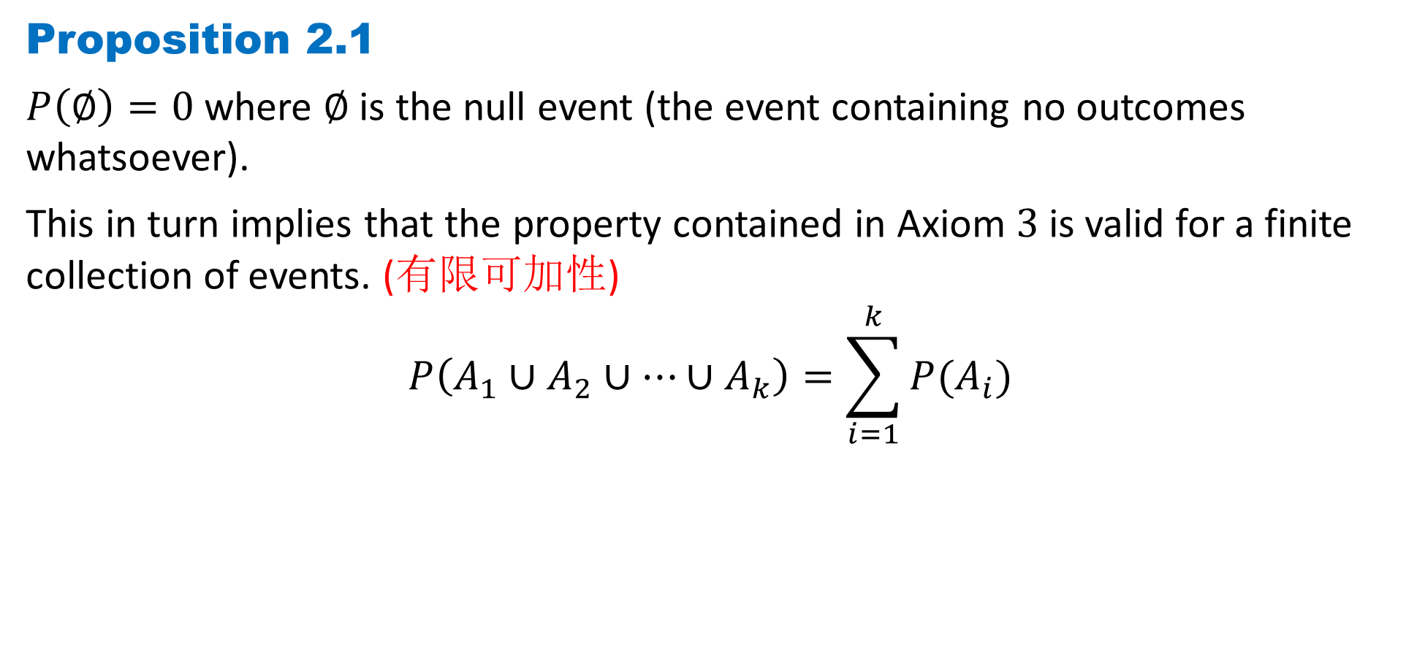
DLI
Proposition 2.1
$P\left(∅\right)=0$ where $∅$is the null event (the event containing no outcomes whatsoever).
This in turn implies that the property contained in Axiom $3$ is valid for a finite collection of events. (有限可加性)
$$P\left(A_{1}∪A_{2}∪⋯∪A_{k}\right)=\sum_{i=1}^{k}{P(A_{i})}$$

Slide 15
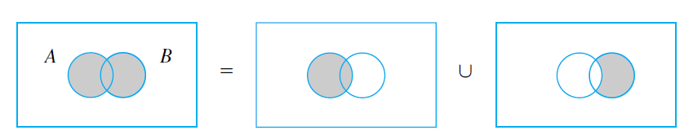
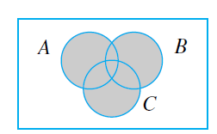
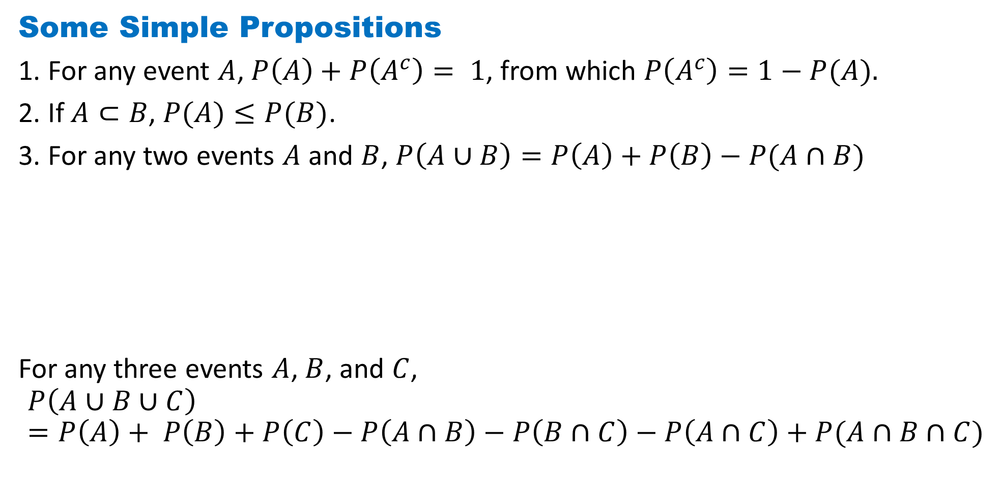
DLI
Some Simple Propositions
1. For any event $A$, $P\left(A\right)+P\left(A^{c}\right)= 1$, from which $P\left(A^{c}\right)=1−P(A).$
2. If $A⊂B$, $P(A)≤P(B)$.
3. For any two events $A$ and $B$, $P\left(A∪B\right)=P\left(A\right)+P\left(B\right)−P(A∩B)$
For any three events $A$, $B$, and $C$,
$$P\left(A∪B∪C\right)=P\left(A\right)+ P\left(B\right)+P\left(C\right)−P\left(A∩B\right)−P\left(B∩C\right)−P\left(A∩C\right)+P(A∩B∩C)$$

Slide 16
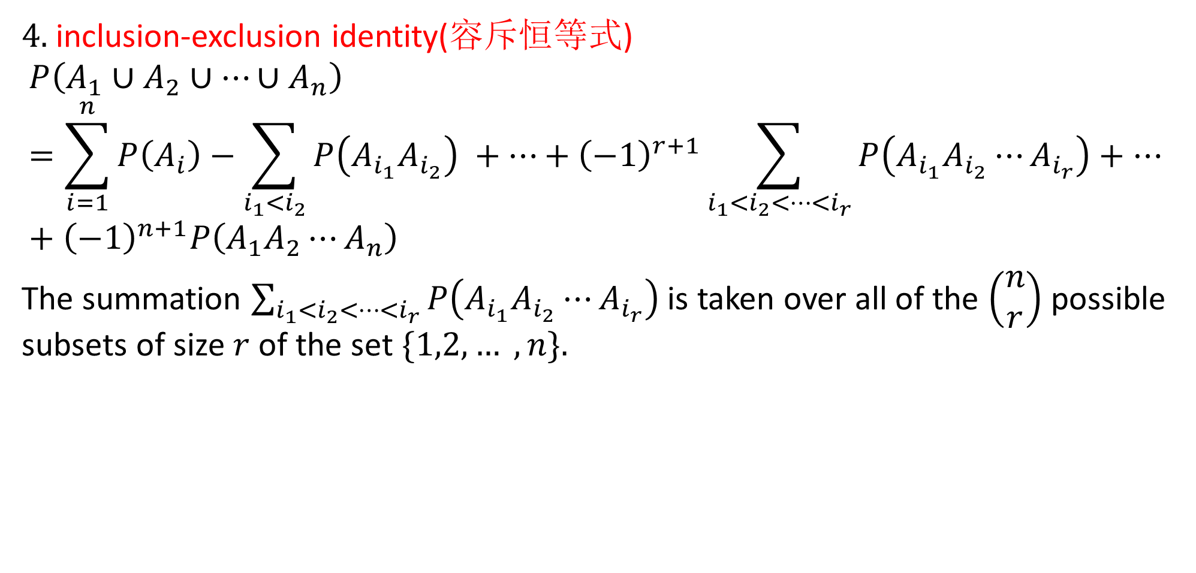
DLI
4. inclusion-exclusion identity(容斥恒等式)
$$P\left(A_{1}∪A_{2}∪⋯∪A_{n}\right)=\sum_{i=1}^{n}{P\left(A_{i}\right)}−\sum_{i_{1}<i_{2}}{P\left(A_{i_{1}}A_{i_{2}}\right)} +⋯+{\left(−1\right)}^{r+1}\sum_{i_{1}<i_{2}<⋯<i_{r}}{P\left(A_{i_{1}}A_{i_{2}}⋯A_{i_{r}}\right)}+⋯+{\left(−1\right)}^{n+1}P\left(A_{1}A_{2}⋯A_{n}\right)$$
The summation $\sum_{i_{1}<i_{2}<⋯<i_{r}}{P\left(A_{i_{1}}A_{i_{2}}⋯A_{i_{r}}\right)}$ is taken over all of the $\left(\begin{matrix}n \\ r\end{matrix}\right)$ possible subsets of size $r$ of the set $\{1,2, … ,n\}.$

Slide 17
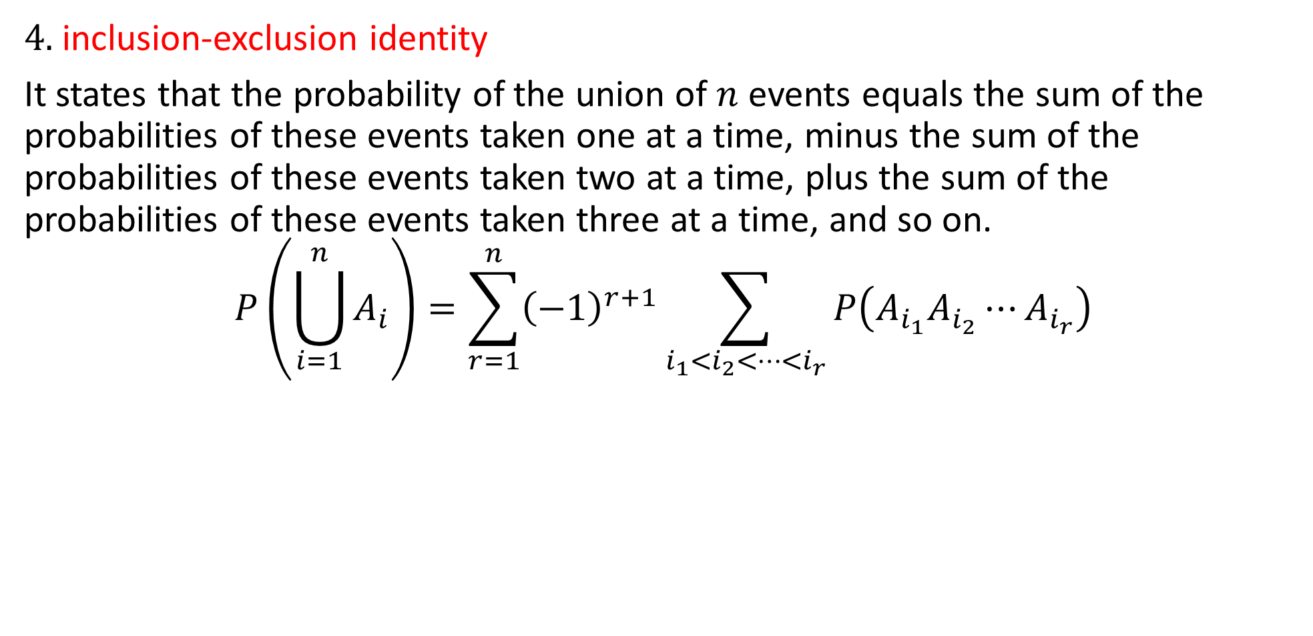
DLI
4. inclusion-exclusion identity
It states that the probability of the union of $n$ events equals the sum of the probabilities of these events taken one at a time, minus the sum of the probabilities of these events taken two at a time, plus the sum of the probabilities of these events taken three at a time, and so on.
$$P\left(\bigcup_{i=1}^{n}{A_{i}}\right)=\sum_{r=1}^{n}{{\left(−1\right)}^{r+1}\sum_{i_{1}<i_{2}<⋯<i_{r}}{P\left(A_{i_{1}}A_{i_{2}}⋯A_{i_{r}}\right)}}$$

Slide 18
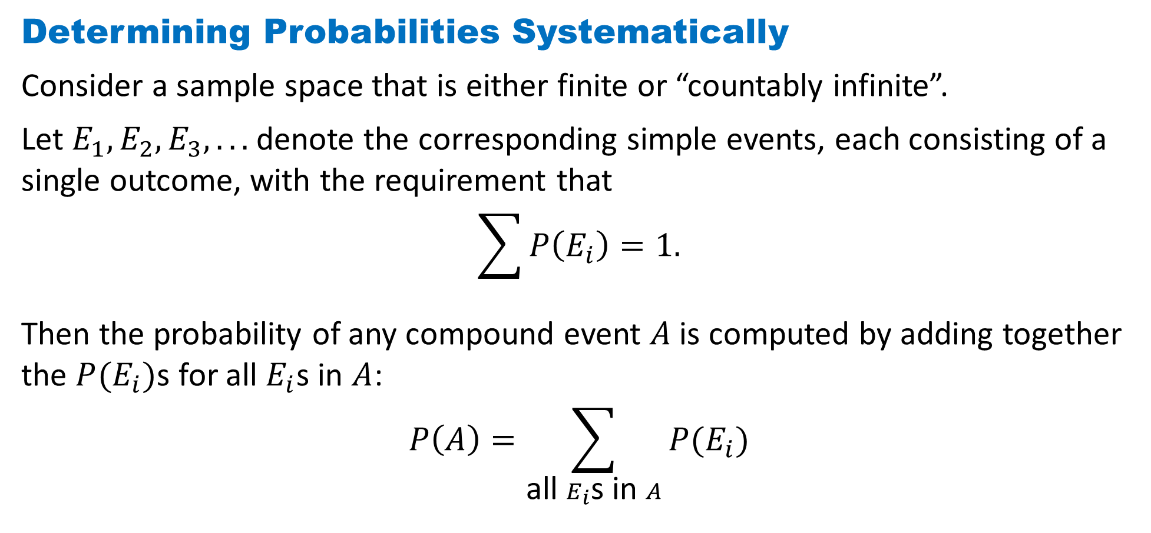
DLI
Determining Probabilities Systematically
Consider a sample space that is either finite or “countably infinite”.
Let $E_{1}, E_{2}, E_{3}, . . .$denote the corresponding simple events, each consisting of a single outcome, with the requirement that
$$\sum{P\left(E_{i}\right)=1.}$$
Then the probability of any compound event $A$is computed by adding together the $P(E_{i})$s for all $E_{i}$s in $A$:
$$P\left(A\right)=\sum_{\text{all} E_{i}\text{s} \text{in} A}{P(E_{i})}$$

Slide 19
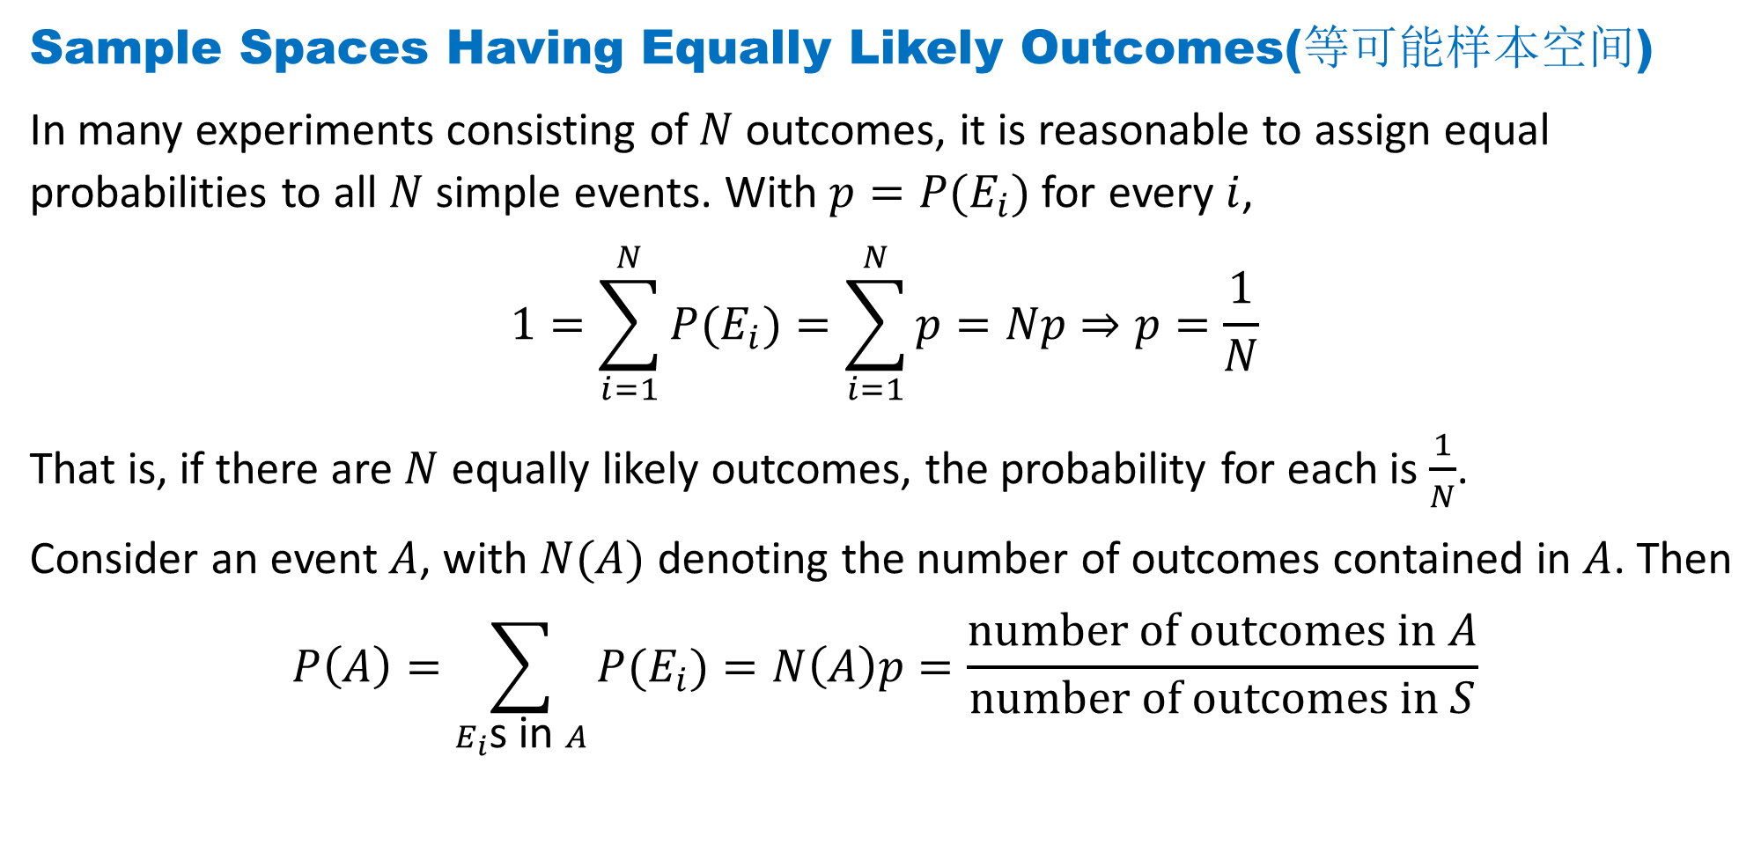
DLI
Sample Spaces Having Equally Likely Outcomes(等可能样本空间)
In many experiments consisting of$N$outcomes, it is reasonable to assign equal probabilities to all $N$ simple events. With $p=P(E_{i})$for every $i$,
$$1=\sum_{i=1}^{N}{P(E_{i})}=\sum_{i=1}^{N}{p}=Np⇒p=\frac{1}{N}$$
That is, if there are $N$ equally likely outcomes, the probability for each is $\frac{1}{N}$.
Consider an event $A$, with $N(A)$ denoting the number of outcomes contained in $A$. Then
$$P\left(A\right)=\sum_{E_{i}\text{s} \text{in} A}{P(E_{i})}=N\left(A\right)p=\frac{number of outcomes in A}{number of outcomes in S}$$

Slide 20
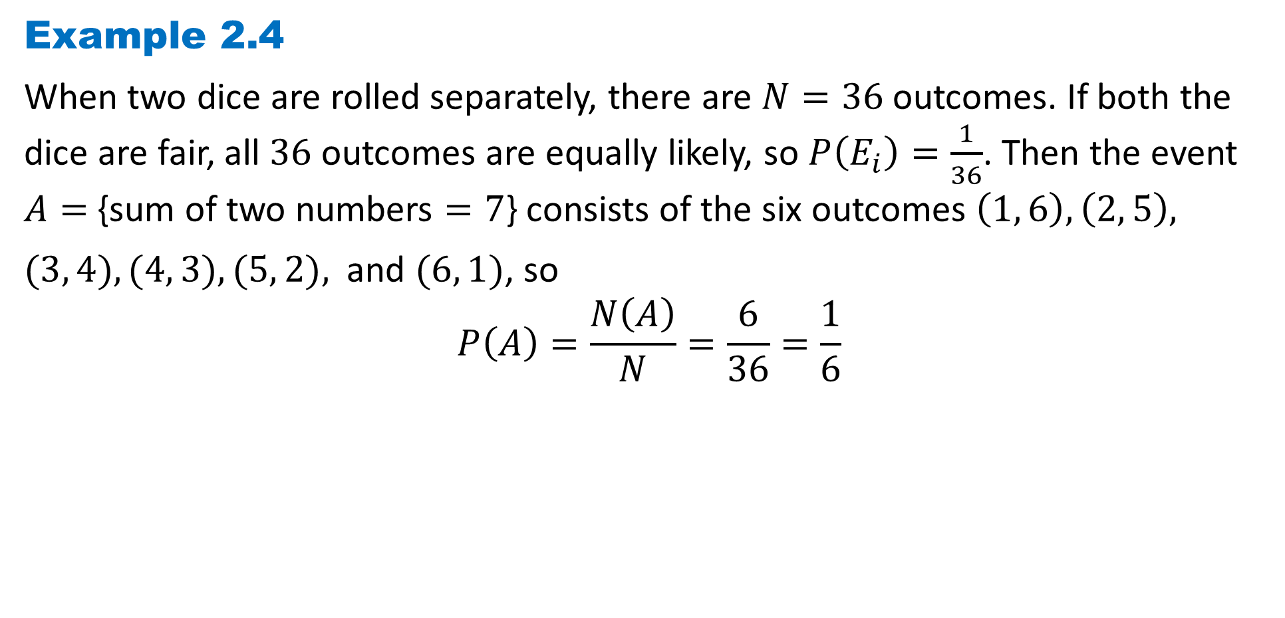
DLI
Example 2.4
When two dice are rolled separately, there are $N=36$outcomes. If both the dice are fair, all $36$ outcomes are equally likely, so $P\left(E_{i}\right)=\frac{1}{36}$. Then the event $A=$ {sum of two numbers $=7$} consists of the six outcomes $\left(1, 6\right), \left(2, 5\right),$
$(3, 4), (4, 3), (5, 2),$ and $(6, 1)$, so
$$P\left(A\right)=\frac{N\left(A\right)}{N}=\frac{6}{36}=\frac{1}{6}$$

Slide 21
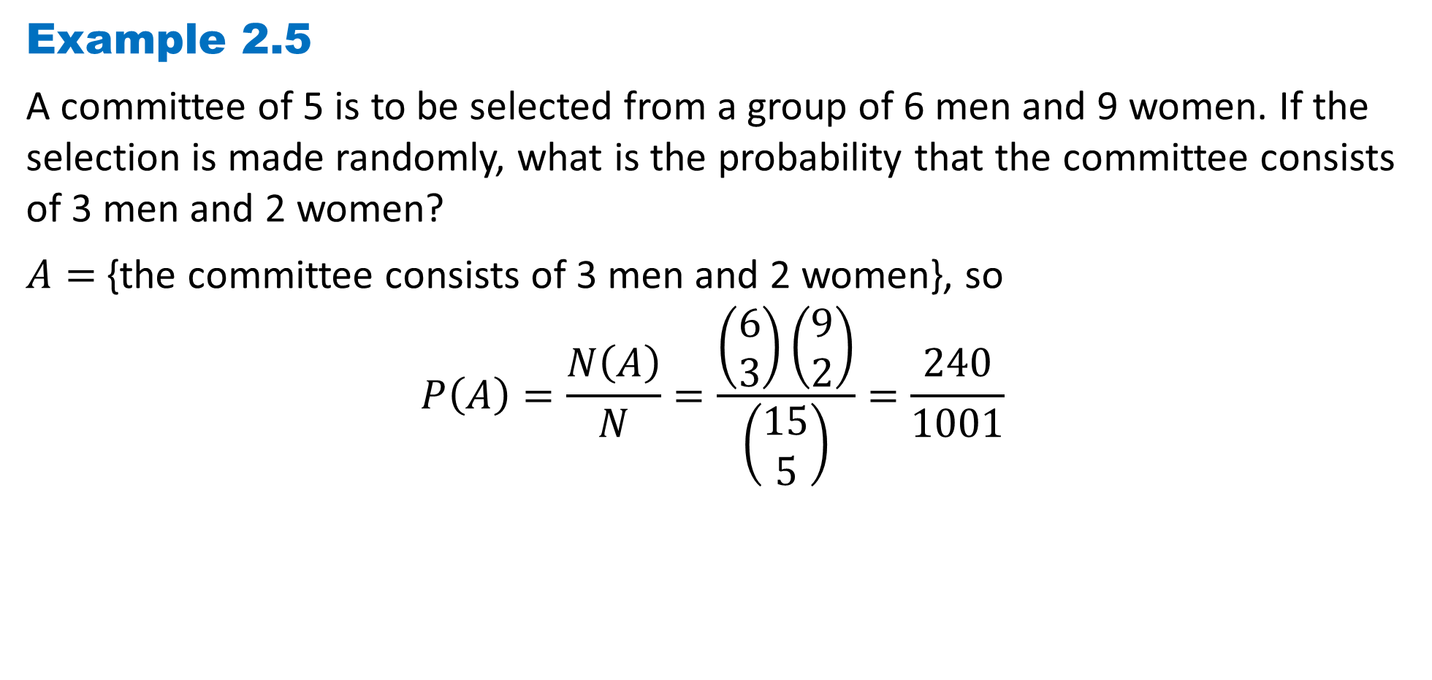
DLI
Example 2.5
A committee of 5 is to be selected from a group of 6 men and 9 women. If the selection is made randomly, what is the probability that the committee consists of 3 men and 2 women?
$A=$ {the committee consists of 3 men and 2 women}, so
$$P\left(A\right)=\frac{N\left(A\right)}{N}=\frac{\left(\begin{matrix}6 \\ 3\end{matrix}\right)\left(\begin{matrix}9 \\ 2\end{matrix}\right)}{\left(\begin{matrix}15 \\ 5\end{matrix}\right)}=\frac{240}{1001}$$

Slide 22
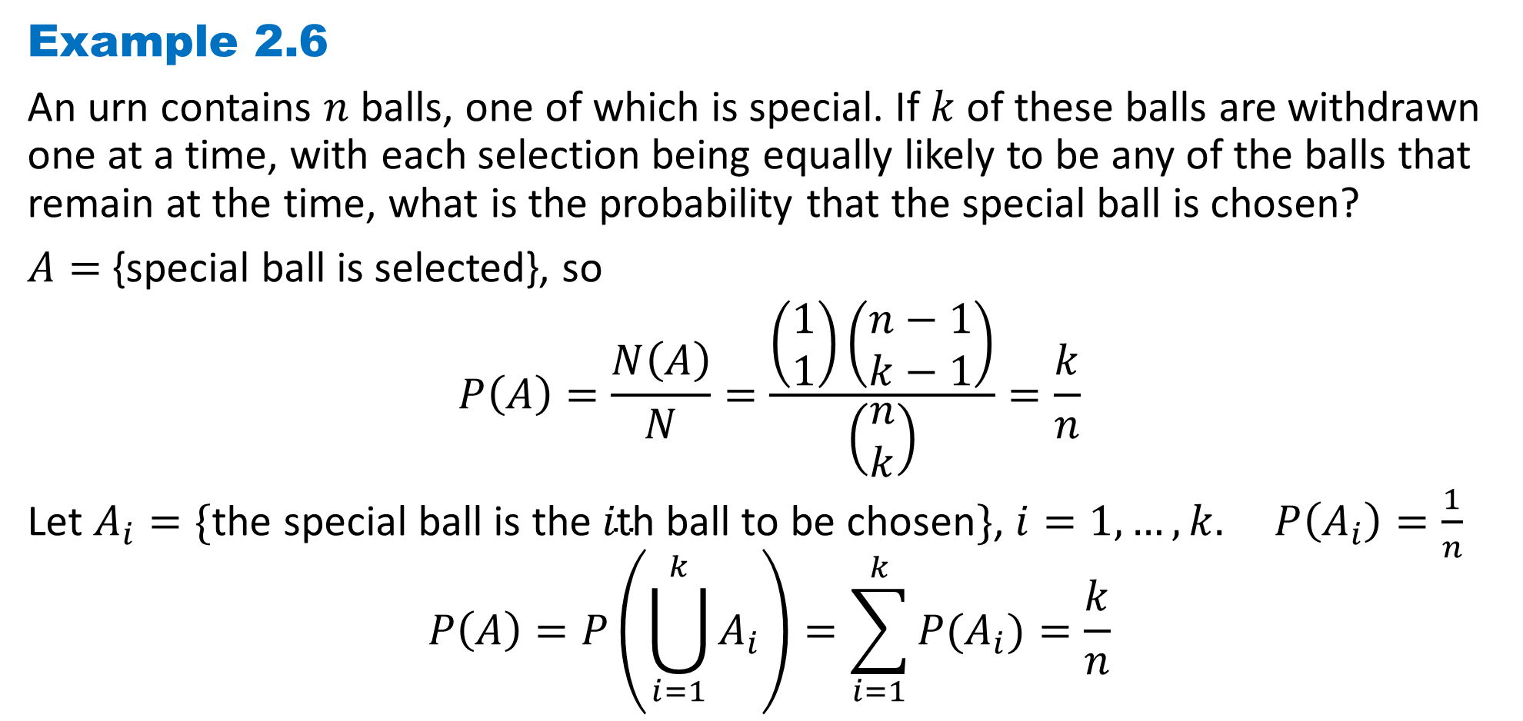
DLI
Example 2.6
An urn contains $n$ balls, one of which is special. If $k$ of these balls are withdrawn one at a time, with each selection being equally likely to be any of the balls that remain at the time, what is the probability that the special ball is chosen?
$A=$ {special ball is selected}, so
$$P\left(A\right)=\frac{N\left(A\right)}{N}=\frac{\left(\begin{matrix}1 \\ 1\end{matrix}\right)\left(\begin{matrix}n−1 \\ k−1\end{matrix}\right)}{\left(\begin{matrix}n \\ k\end{matrix}\right)}=\frac{k}{n}$$
Let $A_{i}=\{\text{the} \text{special} \text{ball} \text{is} \text{the} i\text{th} \text{ball} \text{to} \text{be} \text{chosen}\}$, $i=1, …, k.$ $P\left(A_{i}\right)=\frac{1}{n}$
$$P\left(A\right)=P\left(\bigcup_{i=1}^{k}{A_{i}}\right)=\sum_{i=1}^{k}{P(A_{i})}=\frac{k}{n}$$

Slide 23
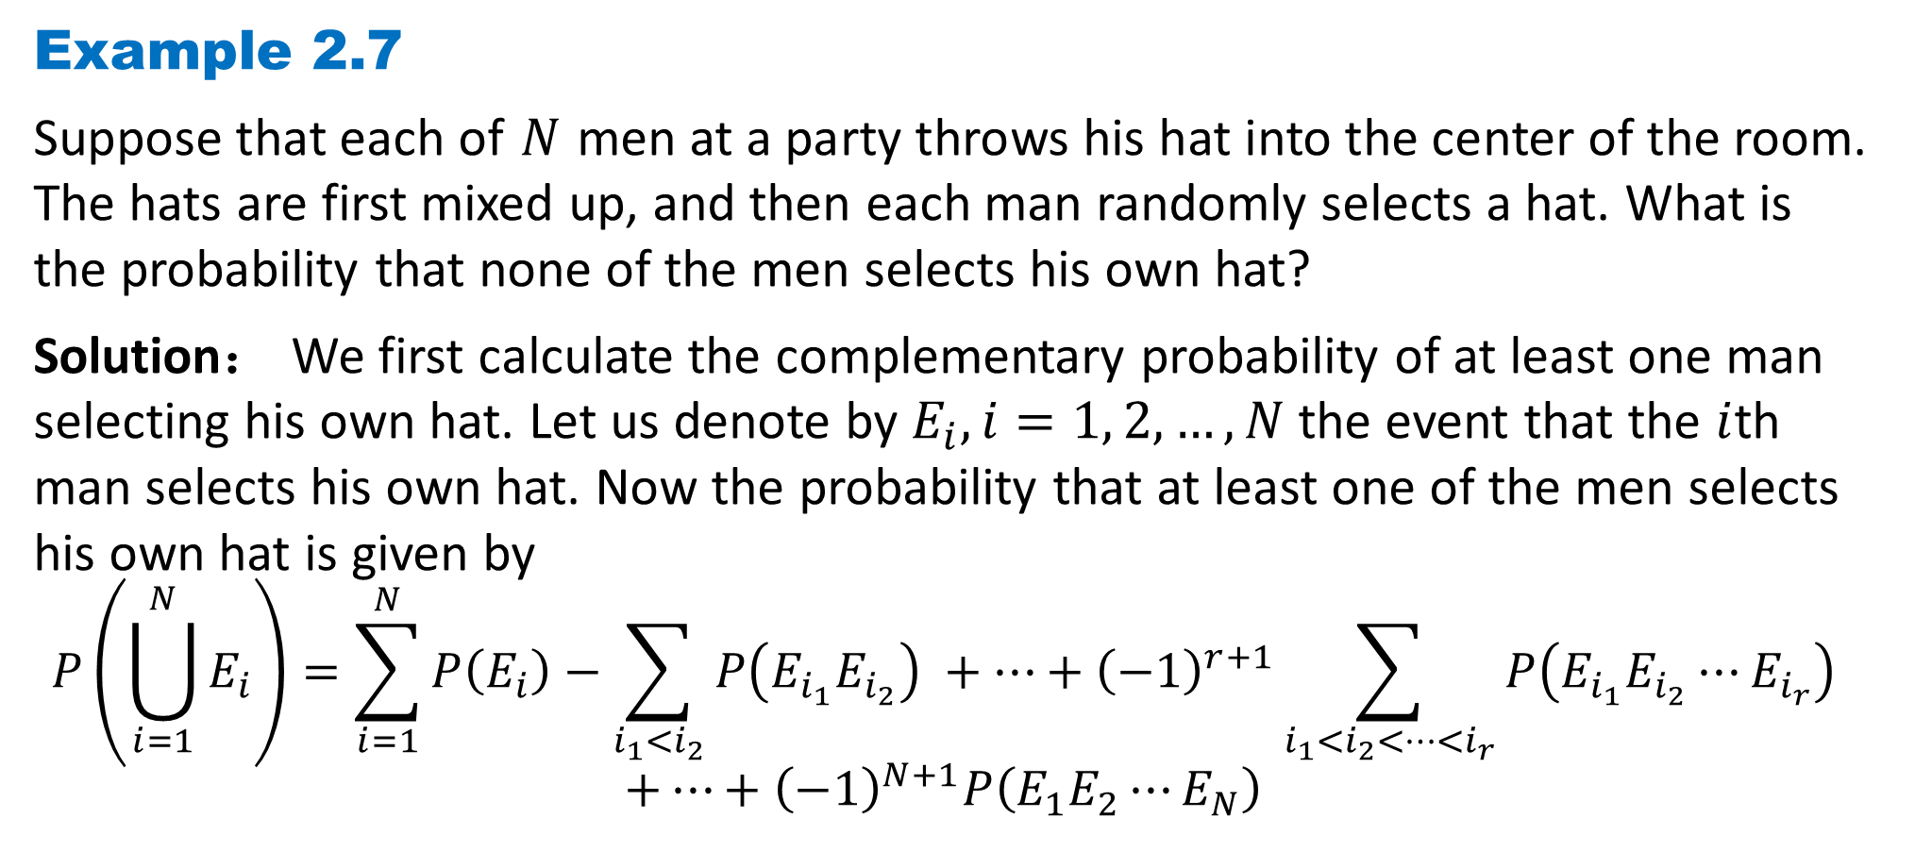
DLI
Example 2.7
Suppose that each of $N$ men at a party throws his hat into the center of the room. The hats are first mixed up, and then each man randomly selects a hat. What is the probability that none of the men selects his own hat?
Solution： We first calculate the complementary probability of at least one man selecting his own hat. Let us denote by $E_{i}, i=1, 2, …, N$the event that the $i$th man selects his own hat. Now the probability that at least one of the men selects his own hat is given by
$$P\left(\bigcup_{i=1}^{N}{E_{i}}\right)=\sum_{i=1}^{N}{P\left(E_{i}\right)}−\sum_{i_{1}<i_{2}}{P\left(E_{i_{1}}E_{i_{2}}\right)} +⋯+{\left(−1\right)}^{r+1}\sum_{i_{1}<i_{2}<⋯<i_{r}}{P\left(E_{i_{1}}E_{i_{2}}⋯E_{i_{r}}\right)}$$
$$+⋯+{\left(−1\right)}^{N+1}P\left(E_{1}E_{2}⋯E_{N}\right)$$

Slide 24
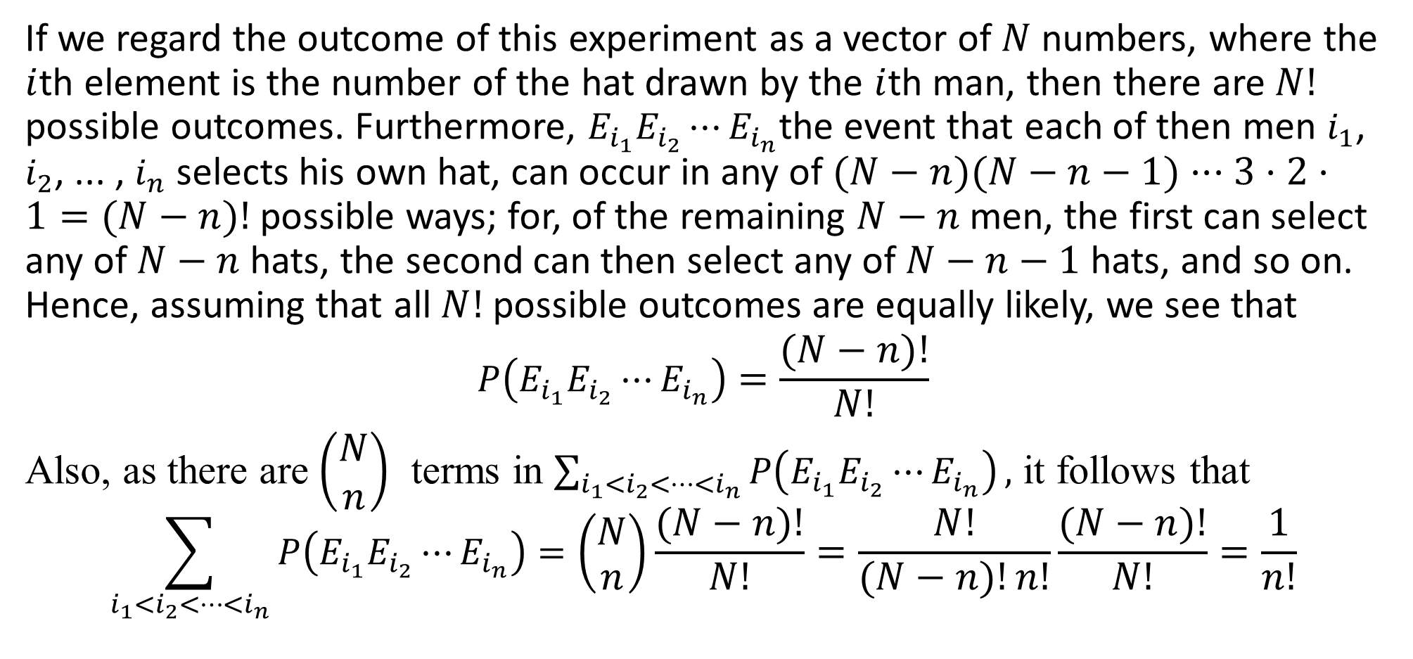
DLI
If we regard the outcome of this experiment as a vector of $N$ numbers, where the $i$th element is the number of the hat drawn by the $i$th man, then there are $N!$ possible outcomes. Furthermore, $E_{i_{1}}E_{i_{2}}⋯E_{i_{n}}$the event that each of then men $i_{1}$, $i_{2}$, ... , $i_{n}$ selects his own hat, can occur in any of $(N−n)(N−n−1)···3·2·1=(N−n)!$possible ways; for, of the remaining $N−n$men, the first can select any of $N−n$hats, the second can then select any of $N−n−1$hats, and so on. Hence, assuming that all $N!$possible outcomes are equally likely, we see that
$$P\left(E_{i_{1}}E_{i_{2}}⋯E_{i_{n}}\right)=\frac{(N−n)!}{N!}$$
Also, as there are$\left(\begin{matrix}N \\ n\end{matrix}\right)$ terms in $\sum_{i_{1}<i_{2}<⋯<i_{n}}{P\left(E_{i_{1}}E_{i_{2}}⋯E_{i_{n}}\right)},$ it follows that
$$\sum_{i_{1}<i_{2}<⋯<i_{n}}{P\left(E_{i_{1}}E_{i_{2}}⋯E_{i_{n}}\right)}=\left(\begin{matrix}N \\ n\end{matrix}\right)\frac{(N−n)!}{N!}=\frac{N!}{(N−n)!n!}\frac{(N−n)!}{N!}=\frac{1}{n!}$$

Slide 25

DLI
Thus,
$$P\left(\bigcup_{i=1}^{N}{E_{i}}\right)=1−\frac{1}{2} +\frac{1}{3!} −…+{\left(−1\right)}^{N+1}\frac{1}{N!}$$
Hence, the probability that none of the men selects his own hat is
$$1−\left(1−\frac{1}{2} +\frac{1}{3!} −…+{\left(−1\right)}^{N+1}\frac{1}{N!}\right)=\frac{1}{2} −\frac{1}{3!}+…+{\left(−1\right)}^{N}\frac{1}{N!}=\sum_{i=0}^{N}{{\left(−1\right)}^{i}\frac{1}{i!}}$$

Slide 26
DLI
Probability as a Measure of Belief
Thus far we have interpreted the probability of an event of a given experiment as being a measure of how frequently the event will occur when the experiment is continually repeated. However, there are also other uses of the term probability.
The most simple and natural interpretation is that the probabilities referred to are measures of the individual's degree of belief in the statements that he or she is making. This interpretation of probability as being a measure of the degree of one's belief is often referred to as the personal or subjective view of probability .
It seems logical to suppose that a "measure of the degree of one's belief' should satisfy all of the axioms of probability. Hence, whether we interpret probability as a measure of belief or as a long-run frequency of occurrence, its mathematical properties remain unchanged.

Slide 27
DLI
Homework
Page 54 Problems
8, 11, 15, 36
Page 58 Theoretical Exercises
6, 8(a), 11
Page 60 Self-Test Problems and Exercises
2, 5, 8

